Slide 1

Medium-Fidelity Design
Window
Mixed Reality
Max Freundlich, Kristen Law, Elisa Lupin-Jimenez

Slide 2

Value Proposition
Tasks
Design Changes
Med-Fi Task Flows
Prototype Overview
Screenshots
Notes:
click

Slide 3
Value Proposition
Tasks
Design Changes
Med-Fi Task Flows
Prototype Overview
Screenshots
Notes:
click

Slide 4
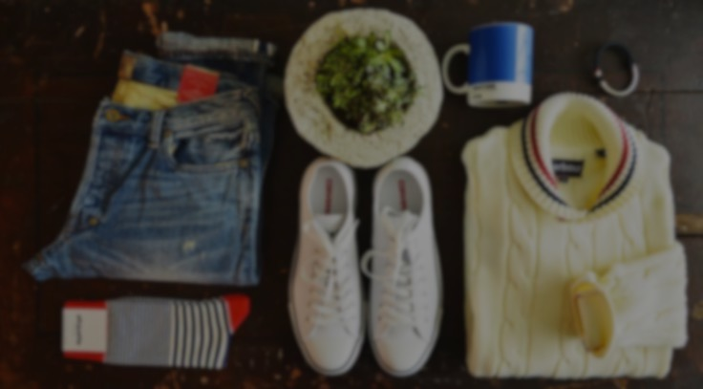
See where your style takes you
Notes:
Changed our value prop to match our mission
Problem: people often go out shopping to find something specifically or get inspired but instead find themselves in a dead-end when they don’t know where to go or what else is out there
Solution: current mixed reality technologies to make a mannequin appear in the store front that is wearing clothes that the store currently holds.
Users = guide our users along their shopping adventure and hopefully give them a “window” of opportunity to discover something new about themselves and the world around them

Slide 5
Value Proposition
Tasks
Design Changes
Med-Fi Task Flows
Prototype Overview
Screenshots
Notes:
click

Slide 6
Value Proposition
Tasks
Design Changes
Med-Fi Task Flows
Prototype Overview
Screenshots
Notes:
click

Slide 7
Simple Task: Browse
Notes:
to browse through a store’s virtual inventory
using our application’s main functionality,
highlight any major UI flaws navigating through the basic screens of the application

Slide 8
Moderate Task: Budget Interview
Notes:
We then designed our moderate task: to find a top for an interview that fits within a $30 budget.
use our filtering options to find formalwear
check out the details of items to check for their prices.

Slide 9
Complex Task: Find Clothing for a Friend
Notes:
to find an item for someone of the opposite gender in a specific size, then send that item to them virtually
use our gender filtering options to find an item
use our sharing option

Slide 10
Value Proposition
Tasks
Design Changes
Med-Fi Task Flows
Prototype Overview
Screenshots
Notes:
click

Slide 11
Value Proposition
Tasks
Design Changes
Med-Fi Task Flows
Prototype Overview
Screenshots
Notes:
click

Slide 12
Improved “Closet” Accessibility
Before
After
Notes:
The biggest design change: add to closet is more clear
Now we expect that people won’t use “add to close” to buy, but plus as in they’ll favorite it

Slide 13
Personalized Settings
Custom measurement input
Before
After
Notes:
Measurements added to settings
Previous settings we had only planned for push notifications and login settings, no real layout
Feedback = added user input for measurements for custom models, gender input

Slide 14
Intuitive Swiping
No more arrows
Preview of next outfit
Before
After
Notes:
Removed arrows from AR enabled screen
Previous screen confused people because they pressed arrows or never looked for other clothes
Now we show a bit of next clothes so people “intuitvely” swipe for it

Slide 15
Value Proposition
Tasks
Design Changes
Med-Fi Task Flows
Prototype Overview
Screenshots
Notes:
click

Slide 16
Value Proposition
Tasks
Design Changes
Med-Fi Task Flows
Prototype Overview
Screenshots
Notes:
click

Slide 17
Simple Task Flow
Login
Choose a store
Start shopping!
Tap on the shirt
Explore details
Notes:
Simple task flow

Slide 18
Moderate Task Flow
Click the up arrow
Select a style
Click ”OK”
Tap on the shirt
Check prices
Notes:
Moderate task flow

Slide 19
Complex Task Flow
Click the up arrow
Select a gender
Click “OK”
Tap on the shirt
Click “Share”
Notes:
Complex task flow

Slide 20
Complex Task Flow (cont.)
Choose friends
Click “Send”
Success!
Notes:
Complex task flow cont

Slide 21
Value Proposition
Tasks
Design Changes
Med-Fi Task Flows
Prototype Overview
Screenshots
Notes:
click

Slide 22
Value Proposition
Tasks
Design Changes
Med-Fi Task Flows
Prototype Overview
Screenshots
Notes:
click

Slide 23

Prototyping Tools
Sketch
iOS components
Limited geometry
InVision
Collaboration
Workflow
Limited motion
Notes:
Sketch = is a graphic design application that provided us with the tools to paste together different elements for our application
Good of sketch = lots of ios components like buttons and status bars that we could copy paste
Bad = geometry choices limited, not freeform in that we can totally capture our vision of what we want it to look like
InVision = is a mobile prototyping application which allowed us to flow between different screens of our application based on different input
Good = easy sharing tools for collab, helped us identify parts that flowed well and parts that didn’t, intuitive
Bad = transitioning between screens via swiping was only a feature available to mobile and not desktop

Slide 24

Limitations
Limited sharing options
No swiping mobility on desktop
Not implementing AR yet
Notes:
Not every article of clothing or outfit is connected to the “Share” button. So this button is only available on items that are critical to completing tasks. The same applies to the “Add to closet” button.
The swipe features are only available on a mobile device. On a web platform they are activated by clicking.
● A large limitation of this prototype is the fact that we are trying to mimic AR with still images. The user has to use their imagination to get beyond this limitation.

Slide 25

“Wizard of Oz” Techniques
Still images in place of AR-enabled scene
“Custom fit” avatar is fixed for now
Notes:
We had to use still images for background of AR scenes, kinda looks like store front
Us pretending that your provided measurements created a custom fit avatar

Slide 26
Value Proposition
Tasks
Design Changes
Med-Fi Task Flows
Prototype Overview
Screenshots
Notes:
click

Slide 27
Value Proposition
Tasks
Design Changes
Med-Fi Task Flows
Prototype Overview
Screenshots
Notes:
click

Slide 28
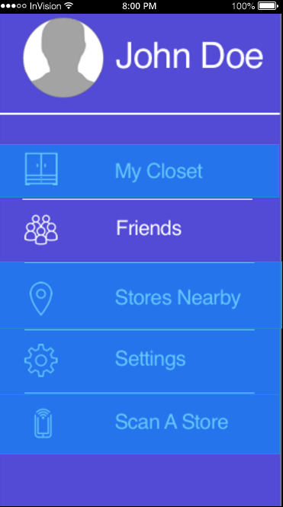
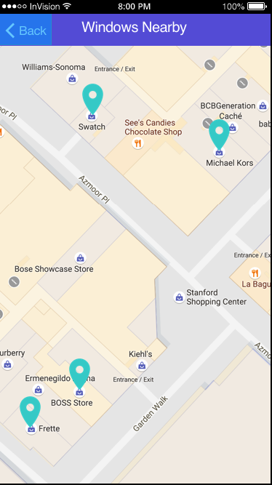
Additional Screenshots
Profile Screen
Stores Nearby

Slide 29

Questions?
Notes:
- Thank you for your time!

